Slide 1


Rawlings Elementary
Title l Annual Meeting
2025-26

Slide 2


MK Rawlings Elementary School
September 25, 2025
5:00pm
In the Café
Tammy Keiper
WELCOME
2025-26 Title l Annual Parent Meeting
Notes:
Evidence: Upload completed presentation and recorded feedback as part of the evidence to support the Annual Meeting Materials. Do not forget the sign-in sheets, and survey/feedback that you receive throughout the meeting.

Slide 3


ALL ABOUT TITLE I
Title I is the largest federal assistance program for our nation’s schools.
The program serves 99 schools in Pinellas County including eligible students in 39 non-public schools.
The Title l goal is that every student achieves high levels of academic proficiency.
Notes:
Highlight the Title l Program here in Pinellas County.

Slide 4


TITLE I FUNDING PROCESS
1. Federal Government
2. Florida Department of Education
4.
3. Pinellas County Schools
Notes:
The Florida Department of Education receives funds from the federal government. Districts receive Title I funds from Department of Education, and the school district distributes these funds to schools based on the percentage of children eligible for free/reduced price lunch; however, students do not have to be from low-income families to receive help.

Slide 5


Title I funds are used for Supplemental Resources
Definition: provided in addition to what is already present or available to compete or enhance it
Notes:
Definition: provided in addition to what is already present or available to complete or enhance it extra academic support and learning opportunities for economically disadvantaged students.

Slide 6
TITLE I PROGRAMS PROVIDE SUPPLEMENTAL RESOURCES
Supplemental Resource | Positive Impact
Additional supplemental personnel: MTSS Coach | Provide coaching for staff, impacts school leadership team, and supports students needing academic and/or behavior supports and interventions.
Supplemental teaching materials, equipment, and technology | Provide resources to supplement student learning
Extended Learning Opportunities (after school programs) | Reading, math, STEM, and enrichment clubs
Parent and Family Engagement Resources and Workshops | Parent and community liaison, family engagement events, activities and resources
Notes:
Use additional slides if necessary. This is where you want to really highlight Title I funding and how it positively impacts your scholars! Additional supplemental personnel (add specific positions)
If there are connections that they can make, they call it out!

Slide 7
Title I Schoolwide Planning and Input
First
Second
Last
Seek Input from school, family, and community members determine how Title I funds are used based on a needs assessment.
Please attend online or in-person meetings/trainings and complete surveys to provide input on Title I funding.
All Title I schools must document that parents are involved in the schoolwide planning process.
Notes:
Evidence for input – input from school can be a survey or notes, which include quotes related to what was shared as feedback AND how this input will be used to inform the PFEP and future engagement activities.
Evidence of Attendance – please include attendance of DIVERSE stakeholder group/s.

Slide 8

Title I Schoolwide Budget
MK Rawlings was provided $74,800.00 to pay for supplemental resources and programs for increased student achievement.

Slide 9
A+ SCHOOLS TITLE I PARENT & FAMILY ENGAGEMENT BUDGET
MK Rawlings was provided $5,400.00 to pay for Parent and Family Engagement resources.
Notes:
SAMPLE ONLY - Delete Slide
Highlight your budget and resources and how they will be used to support family engagement.

Slide 10
Working Together for Student Success
School
School Improvement Plan (SIP)
Title
Title I Schoolwide Plan
Parent
Parent and Family Engagement Plan
School
School-Parent-Student Compact
Title i is now included as a part of the School Improvement Plan
Notes:
As a Title I parent you have the right to be involved in the development of the following plans and documents for our school which can be found on our website (insert website) to view as well as in the Parent Station located (insert location here).
Our school’s Title I Parent Station is located (insert location or photo of Title I Parent Station (front office and on the webpage). Please include photo as part of the evidence monitoring.
You will find a copy of our School Improvement Plan, Title I Schoolwide Plan, School’s PFEP, the School District’s PFEP, Parent’s Right to Know Memo, Upcoming Events, Compact, (insert other documents at your station)
School Improvement Plan (SIP)
Parent and Family Engagement Plan
Title I Schoolwide Plan
School-Parent-Student Compact

Slide 11

Parent-School-Student Compact
The purpose of the compact is to foster student achievement. By signing the Parent-School-Student Compact, teachers, staff, parents and students agree to work together to share the responsibility of helping students meet or exceed state, district and school academic goals.
The Parent-School-Student Compact is updated every year to include parent, student, teacher, and staff input. Parent, student, teacher and staff comments are welcome at any time during the year.
Please review and sign
your child’s Compact.
Our goal is to receive
100% signed compacts!
Notes:
At the elementary level, school compacts are used as a progress monitoring tool through the year during parent teacher conferences.

Slide 12
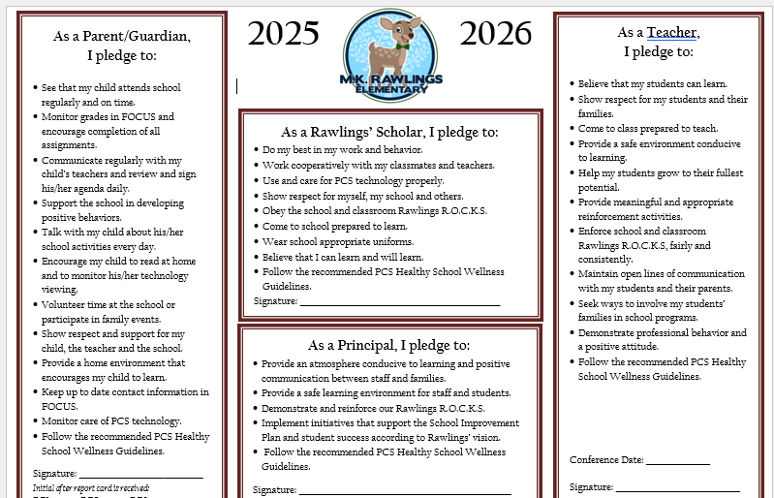
Notes:
Please insert the an example of your updated school compact. Highlight any things that unique to your school’s compact.

Slide 13

Parent and Family Engagement Plan (PFEP)
The PFEP Sections include information about the following:
Parent trainings to increase student achievement
Staff trainings for engaging parents
Communication methods between home and school
Flexible meeting times
Accessibility for parents
Coordinating with other Federal Programs
To access the full LEA PFEP, please visit
www.pcsb.org/titleone
Notes:
Provide information on the specific committees that parents can be involved. Include the purpose, date and time of meetings.
Explain the PFEP and its purpose.
Consider the evidence related Title I Crate, Sample of Evidence,

Slide 14
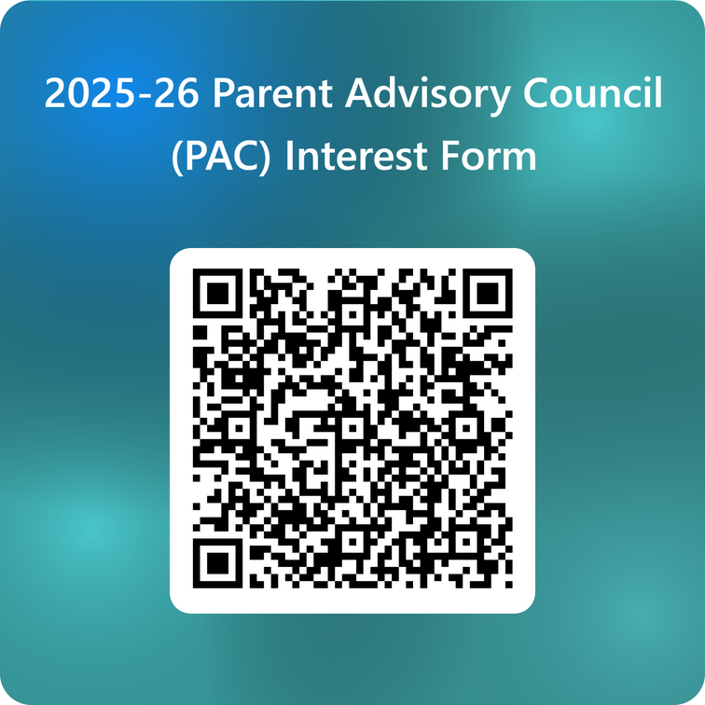

Parent Advisory Council (PAC)
The District has a Parent and Family Engagement Plan. The summary of the plan is in the Title I School & Family Partnership Overview.
You may access the full plan at www.pcsb.org/titleone
The Parent Advisory Council (PAC) is responsible for reviewing and revising the District PFEP.
PAC will meet virtually or in person with the district’s Title I staff.
Each school is committed to having at least one member representative in PAC.
PAC meets twice a year, if you are interested in representing our school please notify, Jacqui Oester or Lori Ann DiPenta
Notes:
Please add your PAC representative in slide and share with your Title I Specialist.
https://forms.office.com/r/r5daaMTENE\

Slide 15

Parent’s Right to Know
As a parent of a student attending a Pinellas County School Public School, you have the right to…
 | Be provided information on your child’s level of achievement on assessments in Reading/Language Arts, Writing, Mathematics, and Science.
 | Request and receive information on the qualifications of your child’s teacher and supplemental personnel working with your child.
 | Be notified of non-highly qualified or out-of-field teachers at the school.
 | Be informed if your child is taught by a non-highly qualified teacher for four or more consecutive weeks.

Slide 16

SCHOOL REPORT CARDS
School Grade and Overview
Population and Enrollment
Assessments – Academic Achievement, Growth, and Population
Assessments – English Language Learners
Graduation and Beyond
Educator Qualifications and Equity
Long-Term Goals and Interim Progress
Accelerated Course Enrollment
Per-Pupil Expenditures
National Data
Available online at https://edudata.fldoe.org/ or Front Office

Slide 17


Let’s Celebrate!
Pinellas County “A” District
MK Rawlings “B” school
Notes:
Based on the FAST data and school grades, there is a lot to celebrate!!
How did your Title I Resources support or enhance the work that you were able to get done?

Slide 18
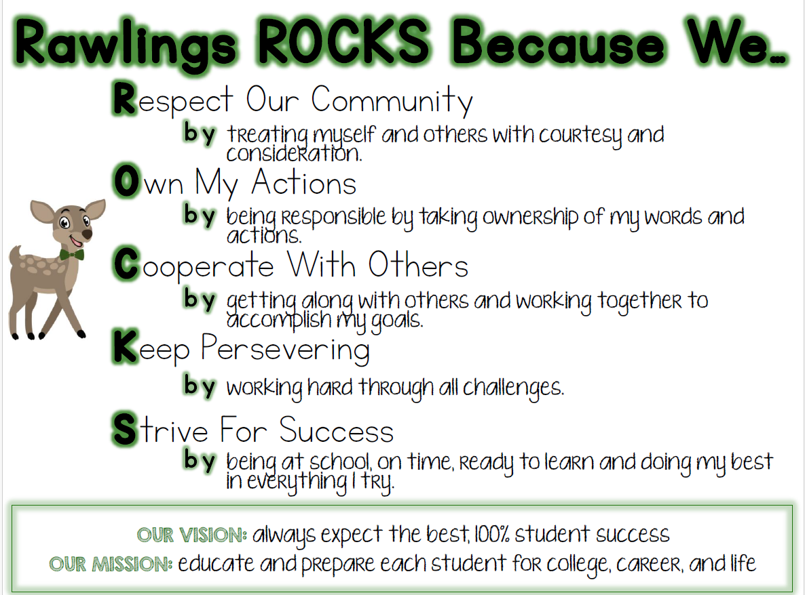
Positive Behavior Intervention (PBIS)
What is PBIS?
Positive behavioral interventions and supports (PBIS) is a schoolwide systems approach aimed at establishing positive student culture. PBIS defines the rules and behaviors we expect across the school.
Notes:
This slide is optional if this will be discussed with classroom teacher
School’s Curriculum
Describe and explain the curriculum (Specific names of texts)

Slide 19

What Does PBIS at Rawlings Look Like?
Expected behaviors are consistent and visible throughout the school (R.O.C.K.S)
Positive behaviors are recognized and acknowledged through our Yearling Buck$ (up to 10 bucks daily)
ELA core, Reading independent, Reading intervention, Writing, Math core, Math Independent, Science, Specials, Lunch, Recess
Yearling Buck$ are given through Focus. Parents can view their student’s behavior through the Parent Portal.
Notes:
Provide information on the specific committees that parents can be involved. Include the purpose, date and time of meetings.
Explain the PFEP and its purpose.
Consider the evidence related Title I Crate, Sample of Evidence,

Slide 20
What Does PBIS at Rawlings Look Like?
Teachers are celebrating positive behaviors each week. In addition, positive behaviors are celebrated monthly through Rawlings school store. Quarterly, there is a schoolwide celebration for students. Students who consistently follow our R.O.C.K.S (cannot have a conduct code of “U” or “N”, cannot have infractions, referrals, or support calls) and have an attendance rate of 80% or more are eligible to attend these celebrations.
Notes:
Provide information on the specific committees that parents can be involved. Include the purpose, date and time of meetings.
Explain the PFEP and its purpose.
Consider the evidence related Title I Crate, Sample of Evidence,

Slide 21


National Dad Take Your Kid to School Day/All Pro Dad Breakfast- October 14 Reading/Math Night- November 13
Lunch Munch- November 20
Chorus Concert- December 11
Student Led Conferences- January 21
Parent Breakfast- February 20
Lunch Munch- March 11
Science Night- April 22
Notes:
Do you have a calendar of key events that are included in your PFEP.
Evidence – Consider this as evidence to include to support Family Engagement.

Slide 22




Additional Resources
Learning at Home Family Resources - https://www.pcsb.org/Page/32836
Volunteer in a Pinellas County School - https://www.pcsb.org/Page/459
Parent Academy POWER HOURS Webinars - https://www.pcsb.org/Page/26534
Partnerships - https://www.pcsb.org/Page/418

Slide 23
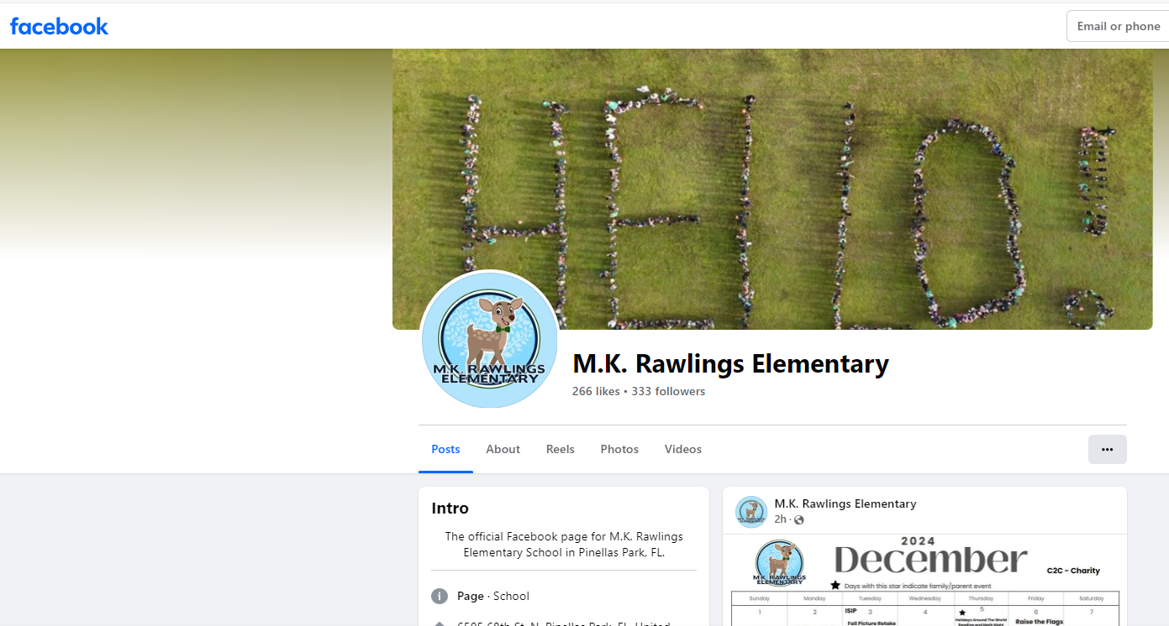

Thank you for your time!
Follow us on Facebook!

Slide 24
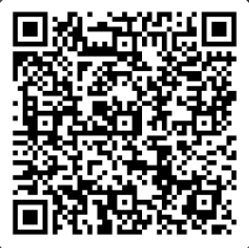

Please take the time to participate in our survey.
Your feedback is greatly appreciated!
Notes:
Please duplicate Microsoft Forms provided or create school survey. To generate a QR code hover over your school’s survey and and right click. Create QR code for this page will be an option.
https://forms.office.com/Pages/ShareFormPage.aspx?id=BZM8c9c5GkaGb_3ye_PH_x-1YNVO6C1FkgA88U6PR2tUNEQzTU0wNkZXVUxVTlpEMU81NkJFMlJNTi4u&sharetoken=FXXhmgwFjSnl0sNz61ki

